Slide 1

Governance and Compliance with Microsoft Purview A getting started guide 2 – Data map
If you think compliance is complicated, feel free to try incompliance!
Jan Cordtz, Snr. Cloud Solution Architect
Microsoft Denmark
Note – in this document the name Purview – if not otherwise
stated - is used for the Data Governance part of Purview.

Slide 2
Get Purview Data Governance running

Slide 3
The Purview “Process”
Installation
Establish Domains
Data Map
Unified Catalog
Establish Governance Domains
Establish Collections
Establish Data Products
Register Sources
Connect assets to Data Products -> Governed assets
Establish assets
Scan
API
Enhance assets
Descriptions (scan?)
Owners
Lineage (scan?)
Glossaries
Classification (scan?)
Sensitivity
Enhance data product
Owners
Glossaries
OKR
Critial Data elements
Data Access
Advanced
Api’s
Workflows
Enforcement of rights

Slide 4
First Purview Tasks

Slide 5
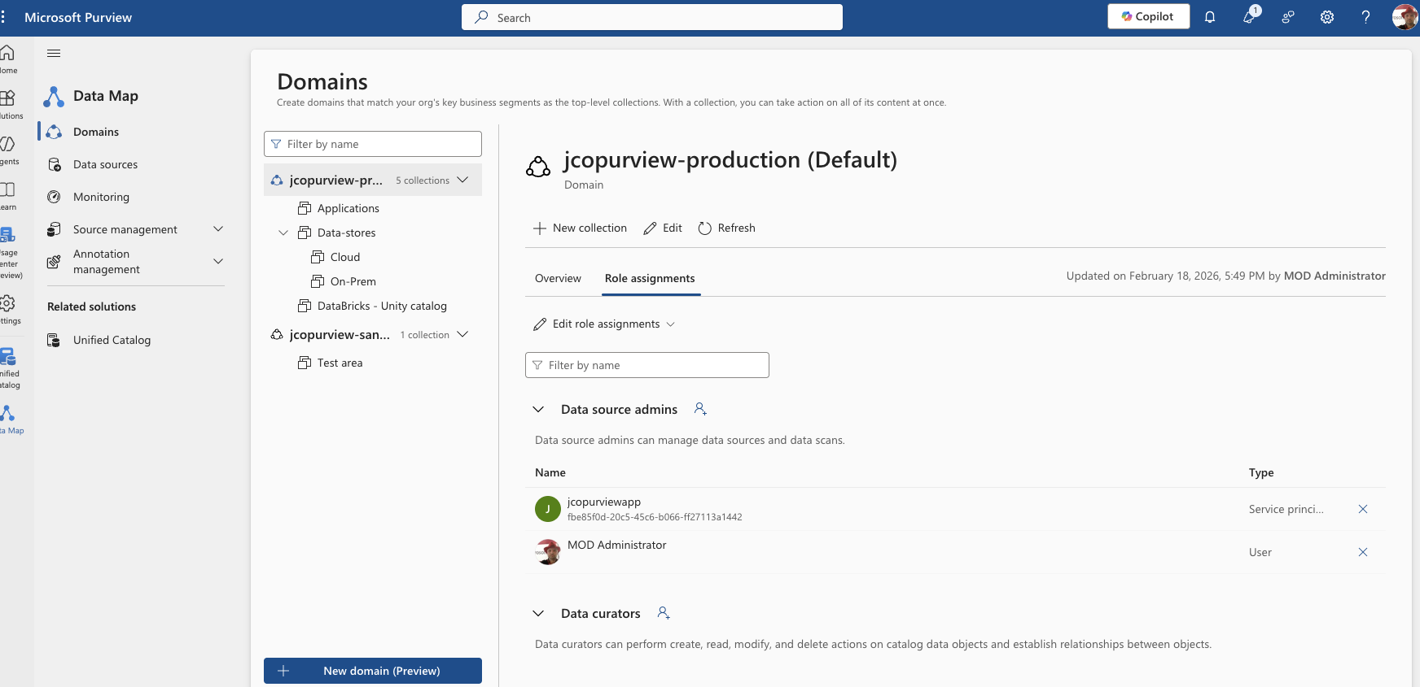
Step 1 – assign rights to the Data Map.
In the Data Map navigate to Domains
Click Role Assignments
Under Data Source admins add the right persons/groups that can add, scan and maintain the sources in Purview.
Under Data curators add the right persons/groups that can maintain the data-assets.

Slide 6
Step 2 – Establish a domain structure.
The domains is a way to separate different “environments” from each other.
The first/top/default domain should (read ”must”) reflect your production Purview content.
The other domains can be used for testing, sandboxes, projects etc.
Notice: You can have a maximum 5 domains.

Slide 7
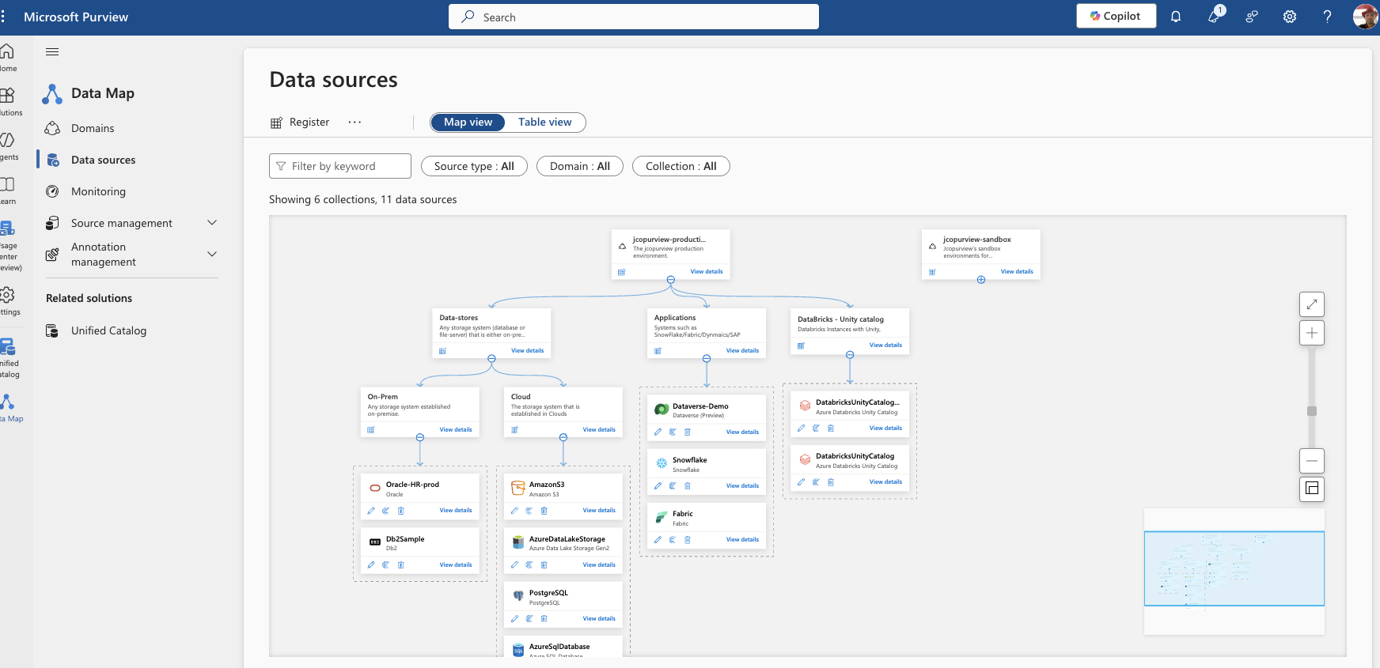
Step 3 – Establish a collection structure in the Data Map.
The collections is a way to separate different sources from each other.
Note:
A source can only present once in Purview
You can have as many collections as you prefer
A source can be moved between collections

Slide 8
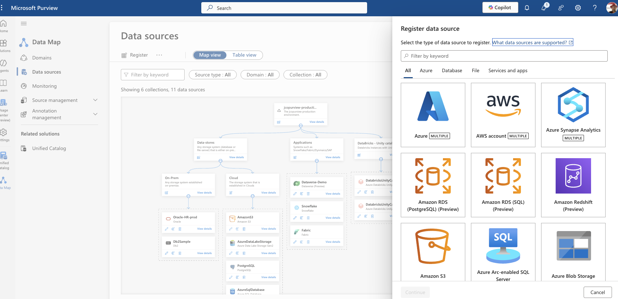
Step 4 – Register sources in the Data Map 1 of 2
At the data sources you are able to register your databases etc..
Note:
A source can only present once in Purview
A list of sources and how to configure them can be found here.

Slide 9
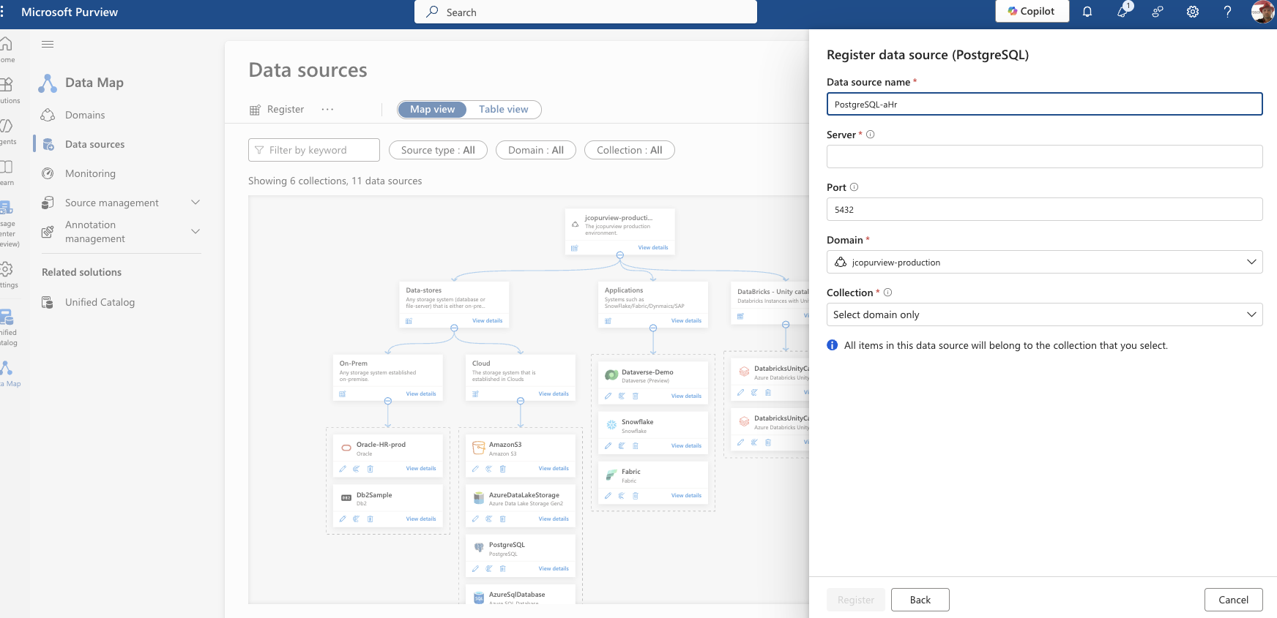
Step 4 – Register sources in the Data Map 2 of 2
When you click “continue” for the data source of your choice a screen request information about the “server” in question. This screen differs depending on the source chosen.
Note:
No validation is done at this point for the existing of the server not ability to connect.
This information cannot be edited afterwards.

Slide 10
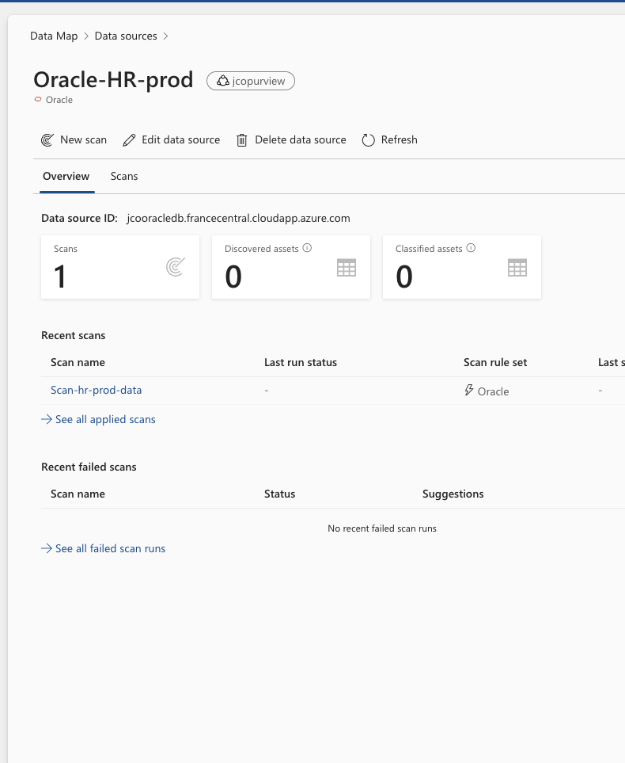
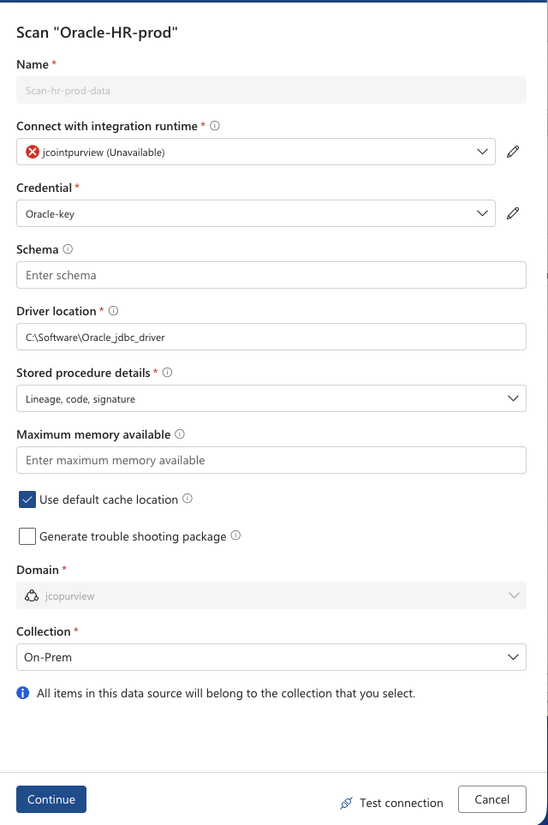
Step 5 – Scan sources in the Data Map.
The scans runs a metadata query against the source and register the data assets
Note:
Depending on the source different inputs are requested by Purview
A list of sources and how to configure them can be found here.

Slide 11
The “first” data asset
Data Map

Slide 12
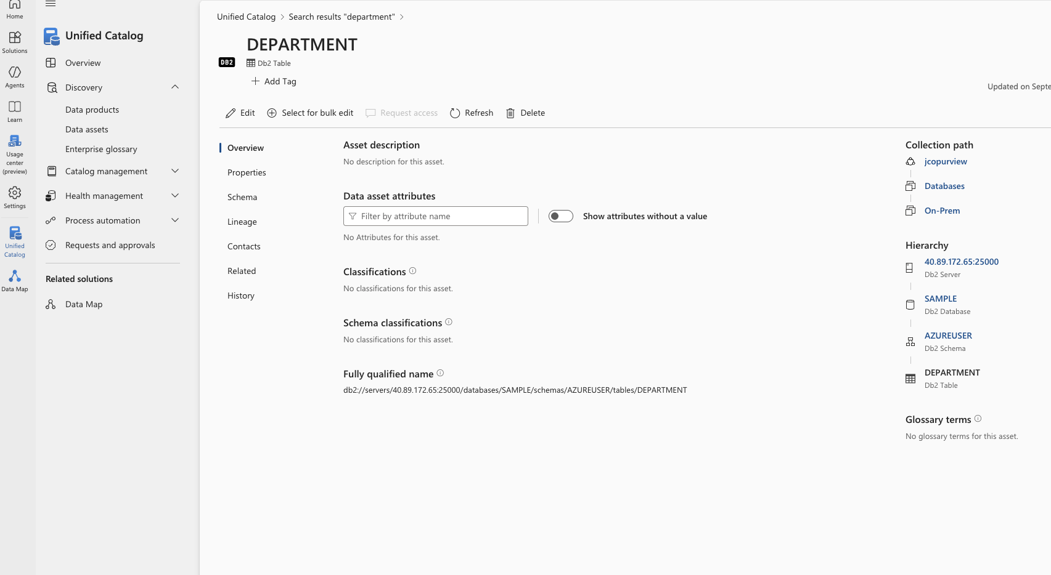
The “first” data asset after a scan - overview
Query your data assets – notice this is found in the unified catalog
The overview tab displays the overall information about the assets like description, classifications, collection path and hierarchy.
The information is only present if it is found in the source.

Slide 13
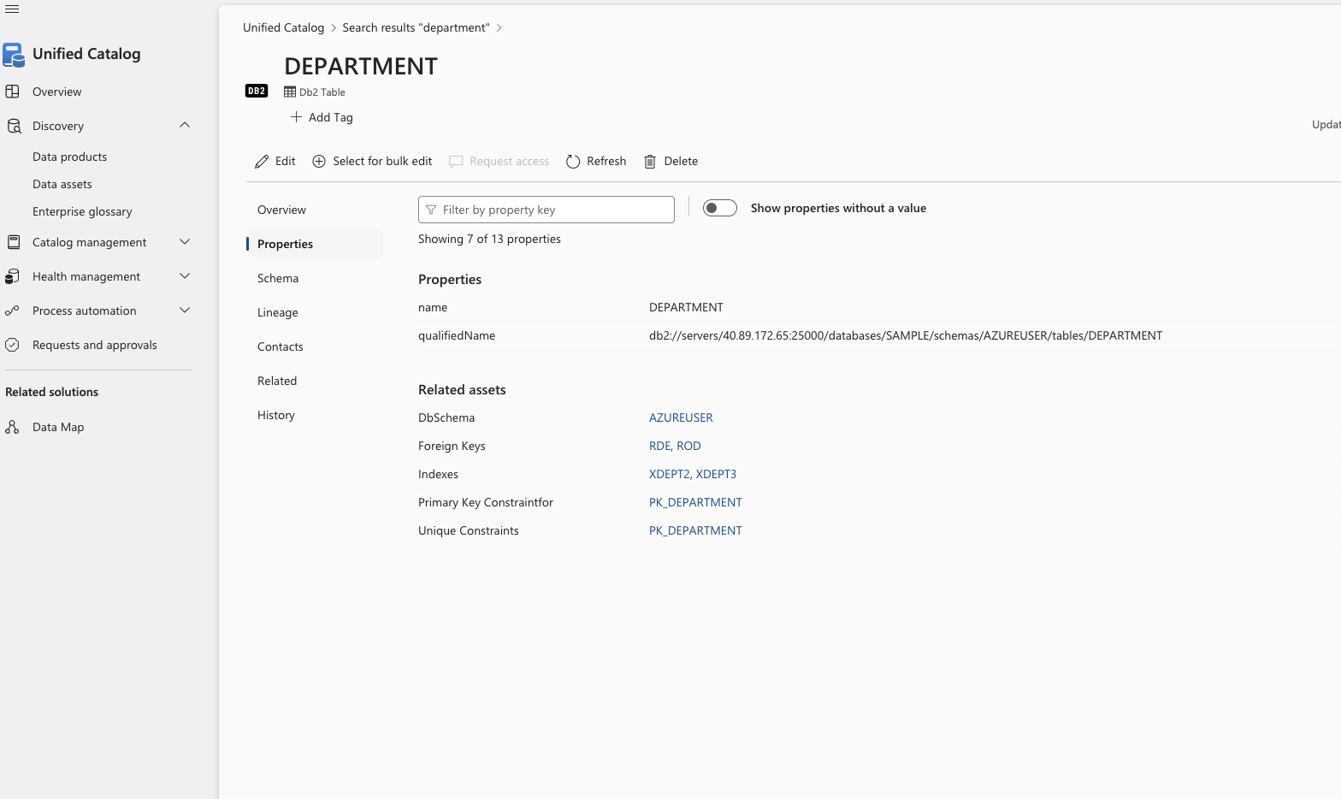
The first data assets after a scan - properties
The properties tab displays the more technical information for a given asset. This varies depending on asset type.
The information is only present if it is found in the source.

Slide 14
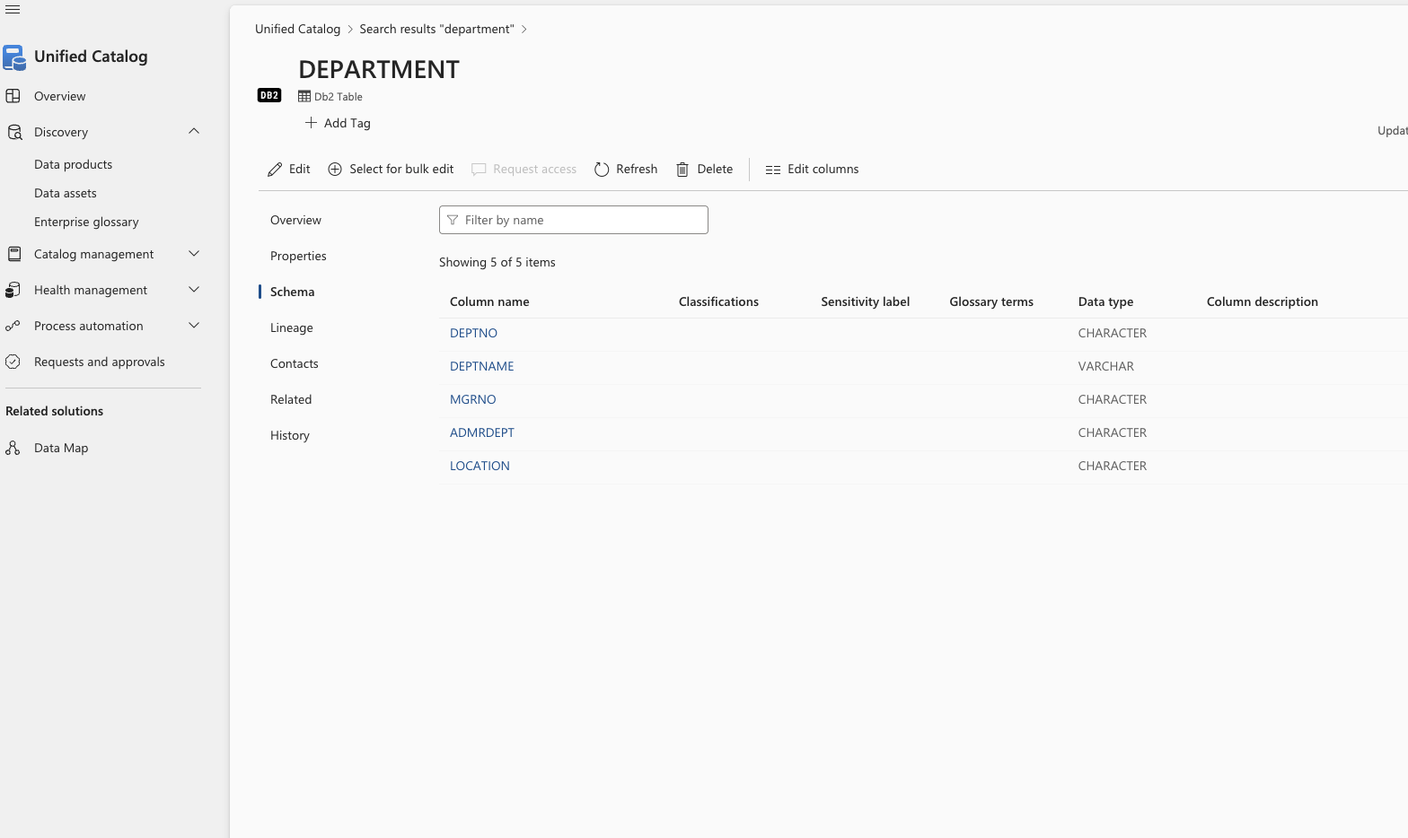
The first data assets after a scan - schema
The schema tab displays any schema found with the asset. This varies depending on asset type.
The information is only present if it is found in the source,

Slide 15
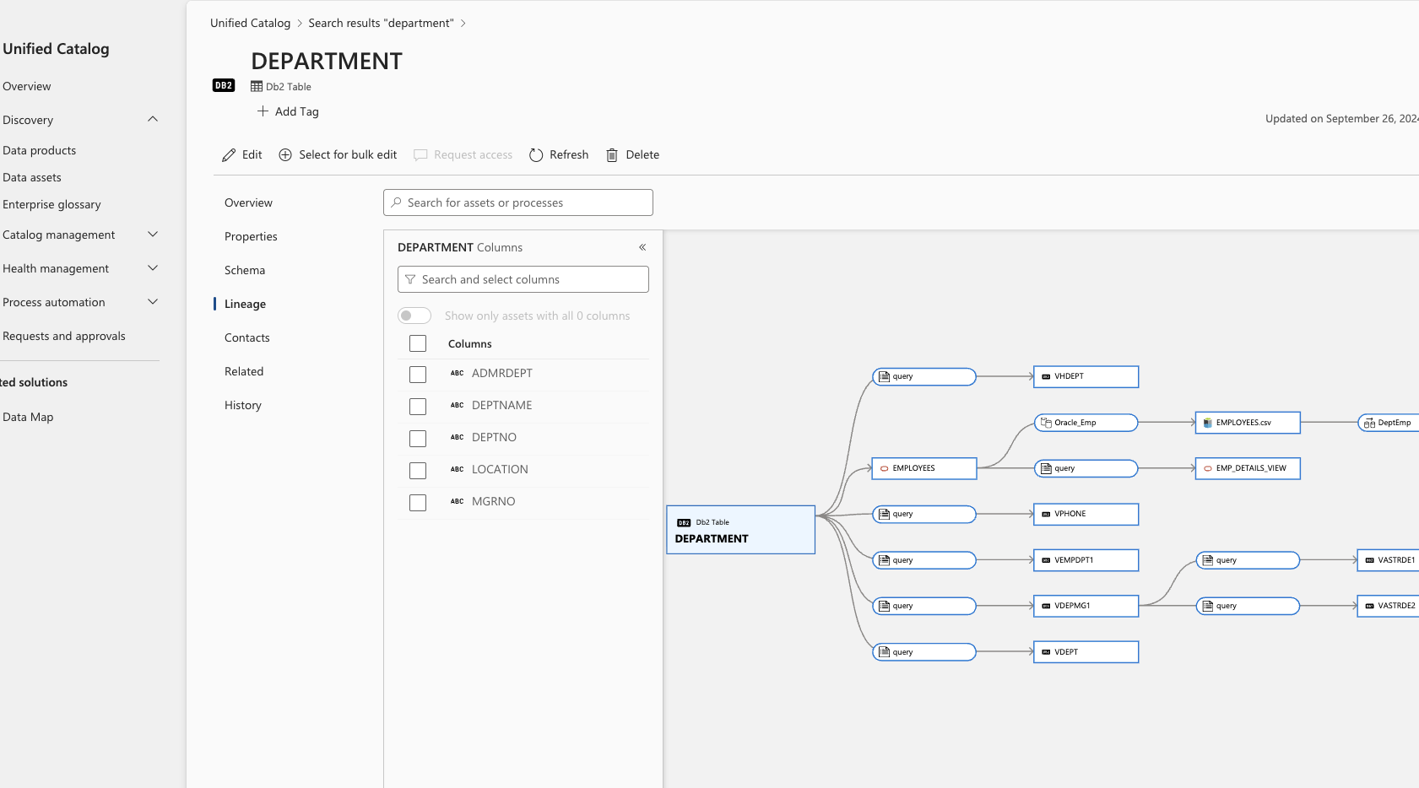
The first data assets after a scan - lineage
The lineage tab displays any connections found with the asset.
This varies depending on asset type.
The information is only present if it is found in the source like views and stored procedures. If it is from a stored procedure this must have been executed.

Slide 16
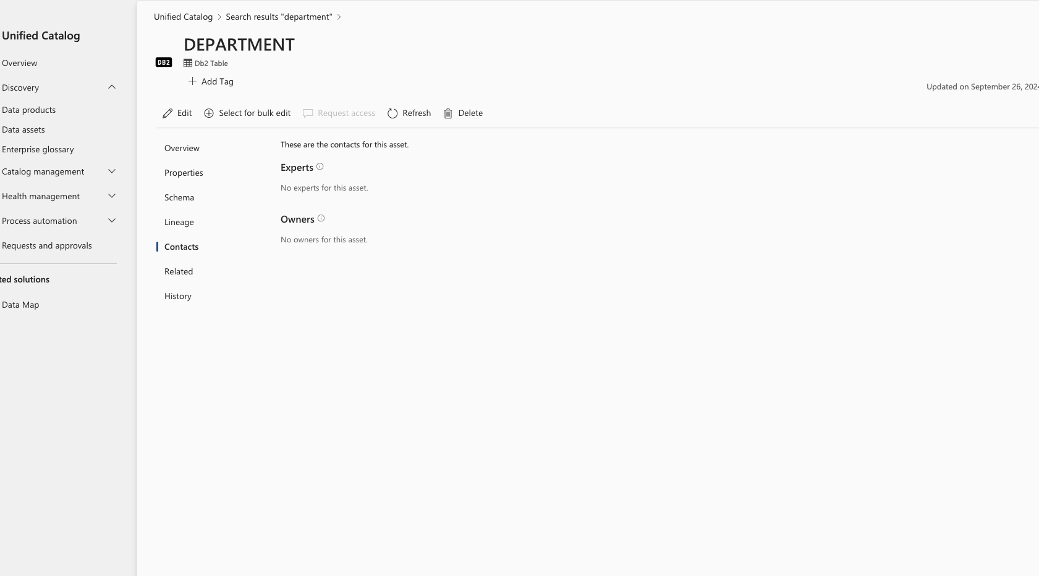
The first data assets after a scan - contacts
The contacts tab will be empty for any new asset.

Slide 17
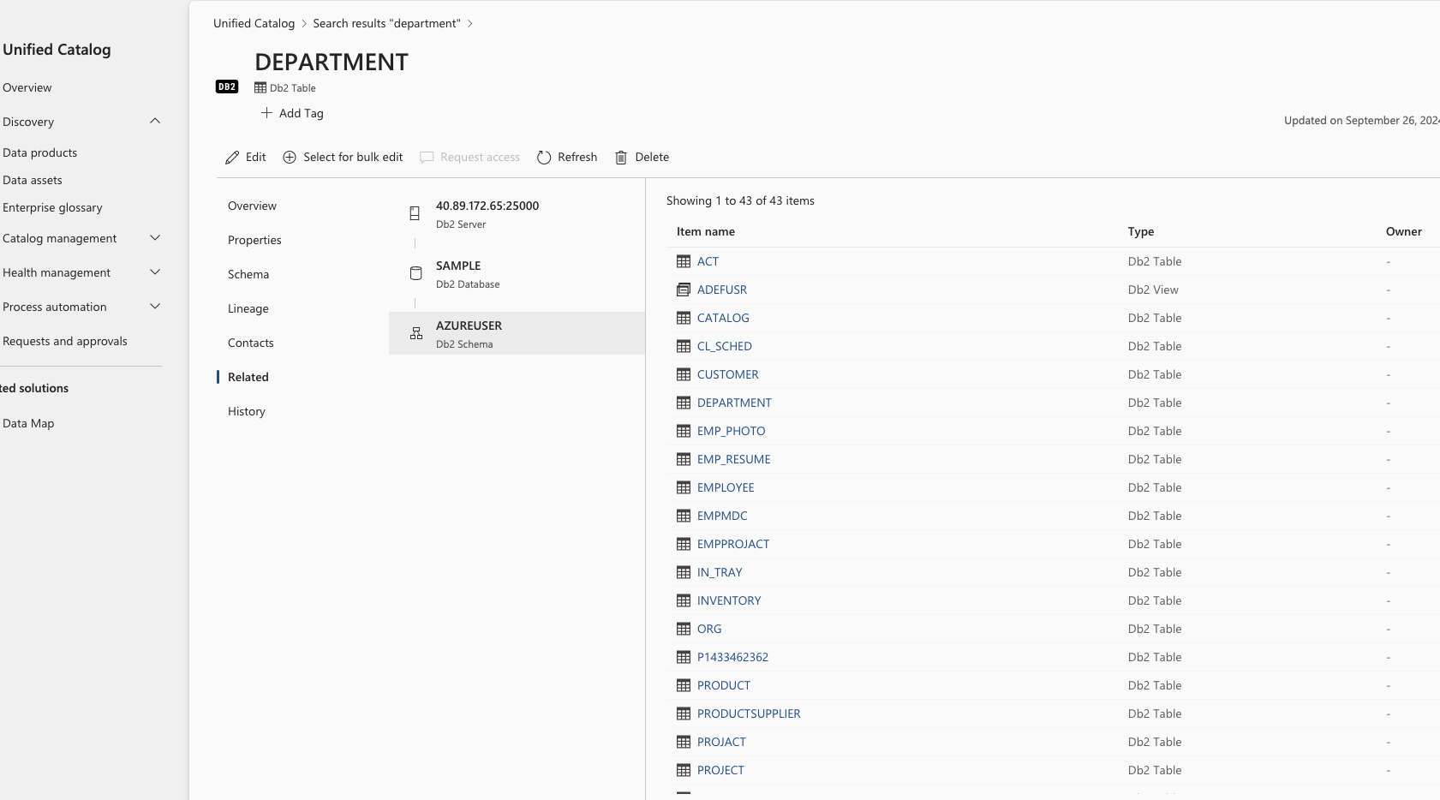
The first data assets after a scan - related
The Related tab will show any other assets that is present in the same source as the asset being watched.
Data Map

Slide 18
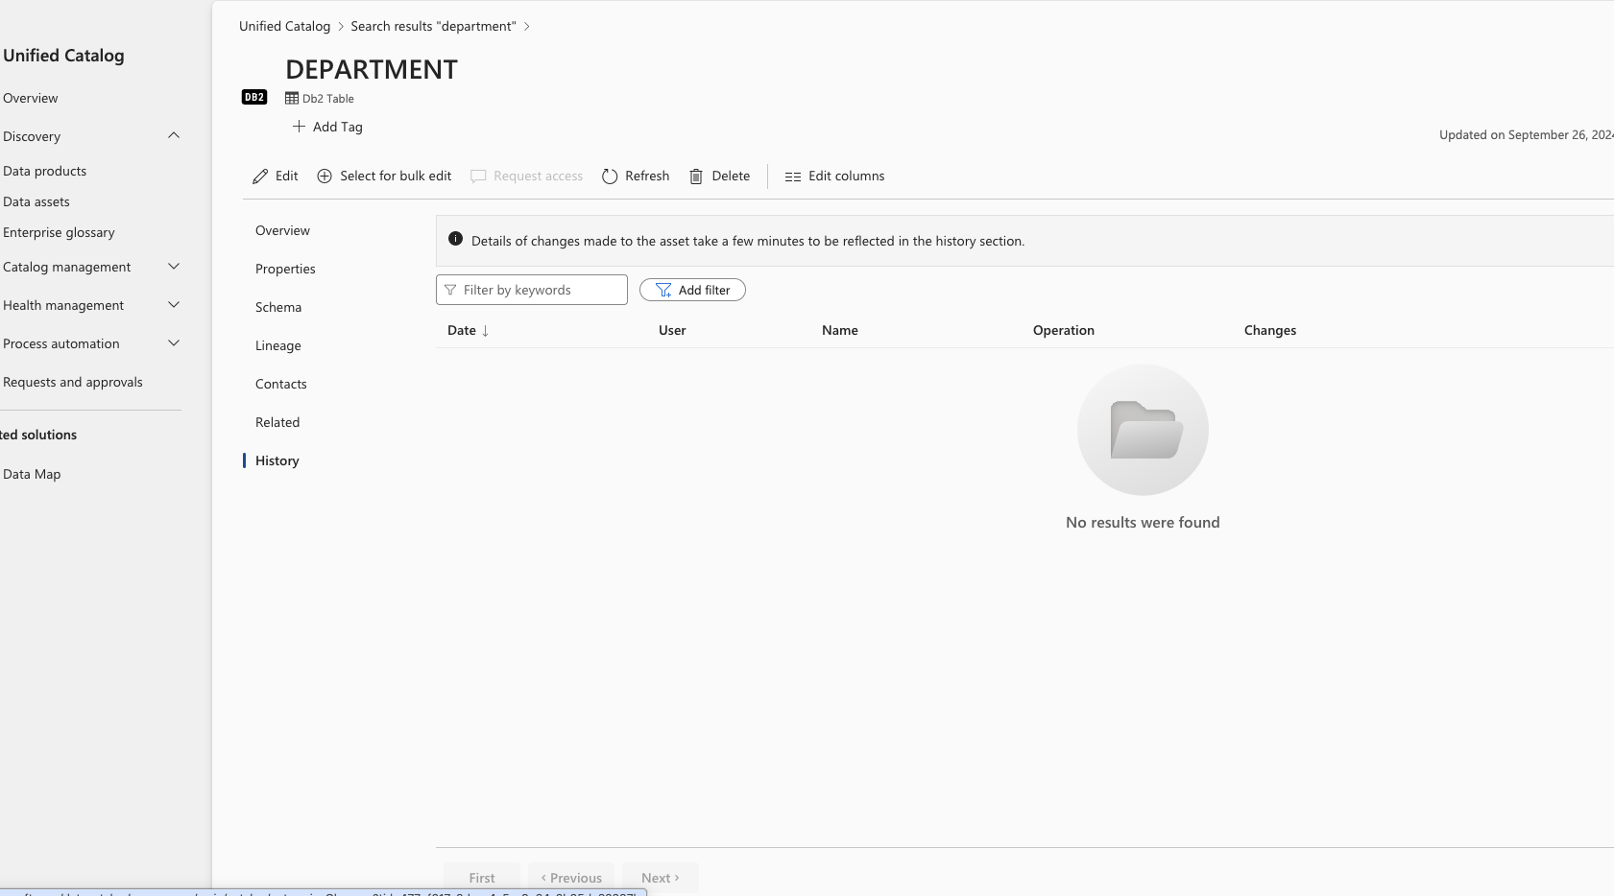
The first data assets after a scan - history
The History tab shows any changes that has been made to the asset after it was scanned.
Purview logs changes regarding Classifications, Data assets, Glossary terms, Business assets, Domains, Collections, Role assignments, Data sources, Scan, Scan rule set, Credential, Policy.
In the Purview Data Map only changes to classifications, data assets, business assets, and glossary terms are shown.
All changes can be found in the Purview Audit “app”
Data Map

Slide 19
Enhancing the “first” data asset
Data Map

Slide 20
Changing the “first” data asset
Elements most likely to be added on the “first” data asset
Overview
Add description, missing classifications, glossary terms and more…
Properties
No changes
Schema
No changes, remember that a columns is also a data assets, so you could “shortcut” to this information through the “table”.
Lineage
Add any missing lineage
Contacts
Add person information
Related
Changes not possible
History
Changes not possible

Slide 21
Add on information to data assets
Data Map

Slide 22
“Add-on” items for a data asset
The following items are information maintained in Purview itself.
Glossary
Glossary terms are individual concepts that define the business, processes, and systems used in an organization.
Data asset attributes
Data asset attributes are a type of custom metadata in Microsoft Purview Unified Catalog that you can create and apply to your organization's data assets.
Classifications
Classifications are used for describing what content a data asset contains.
Sensitivity labels
Gives you possibility to mark data assets to reflect the intended usage.
The maintenance and further description are described in the following slides.

Slide 23
Glossary
Glossary terms are individual concepts that define the business, processes, and systems used in an organization. You can apply them across a data estate, relating to data assets and data products to provide business context to your users. A technically named SQL table becomes less mysterious once it's linked to your "Account" business term, since users can immediately see what aspect of the business it's related to.

Slide 24
Data asset attributes
Data asset attributes are a type of custom metadata in Microsoft Purview Unified Catalog that you can create and apply to your organization's data assets. These user-defined attributes provide a business or organization level context to an asset, helping data consumers understand the role an asset plays in the organization.
Data asset attributes must be connected to one or more technologies and the asset types associated with those.
The structure is as follows:
Attribute group – the heading of the attributes belonging together
Has one or more
Attribute – the set of attributes that can/must be entered. Note - Each attribute is connected to the asset types.

Slide 25
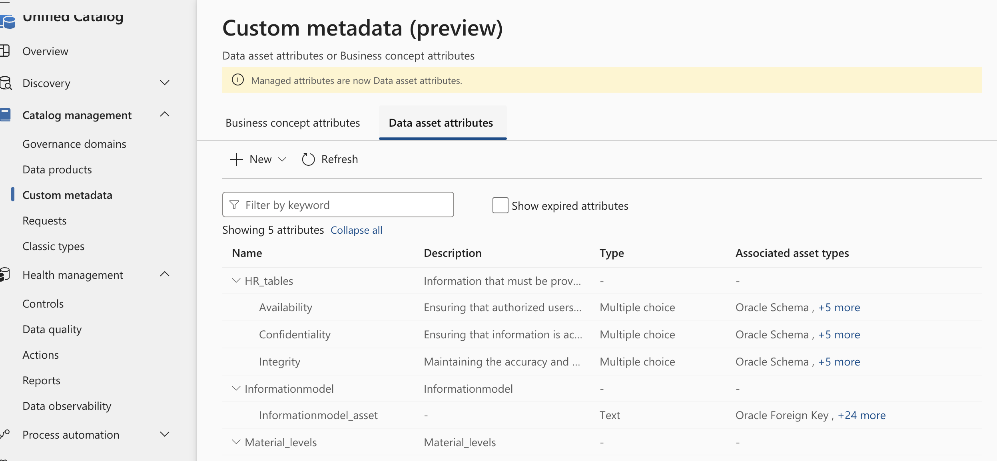
Data asset attributes - maintain

Slide 26
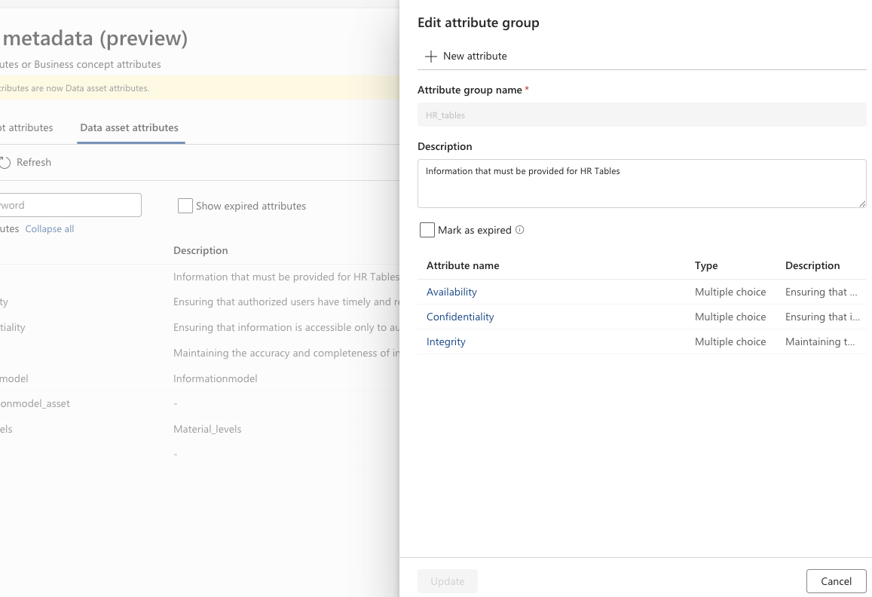
Data asset attributes – attribute group
The attribute group consist merely of a name and an optional description You can from this screen get to the attributes.

Slide 27
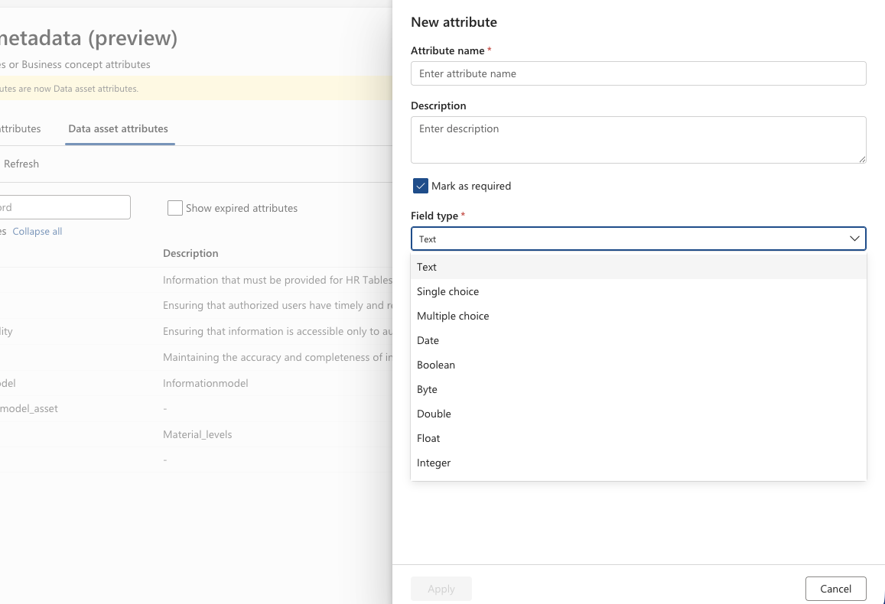
Data asset attributes – attribute 1
The attribute name consist of a name and an optional description It also has a Field type that can be one the following values:
Text – any text
Single Choice – a list from which you must choose one value
Multiple Choice – a list from which you must choose one or more values
Date – a date field
Boolean – a yes/no field
Byte - a charcater
Double – a number of type double
Float – a number of type float
Integer – a number of type integer

Slide 28
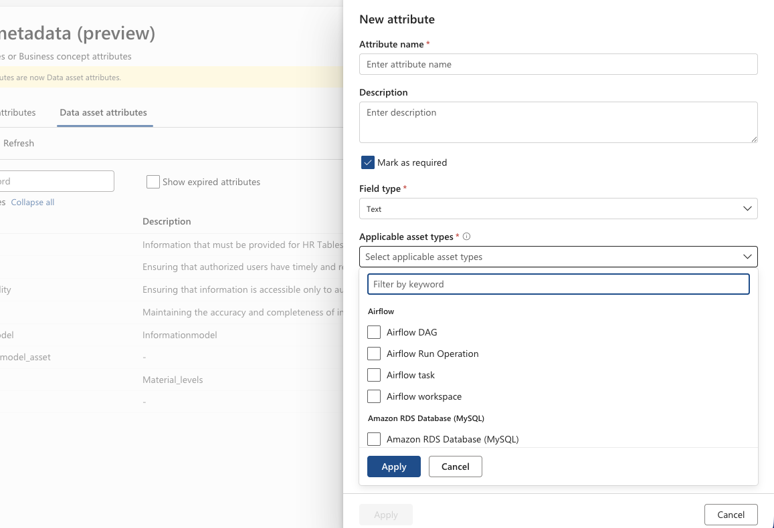
Data asset attributes – attribute 2
The attribute must also be connected to one or more asset types where it will be offered as an option.

Slide 29
Classifications
Classifications are used for describing what content a data asset contains. Often this is PII related information like name, e-mail, address etc. But it can be any information valuable for the users of Purview content. These classification can be assigned through the scans and/or manually.
The structure is as follows:
Scan rule set – the set of classification to be applied during a scan. Note - A scan rule set is tied to a specific source type.
Has one or more
Classification – the classification header
Has one or more
Classification rule – the specific technical rule(s) to be applied during the scan

Slide 30
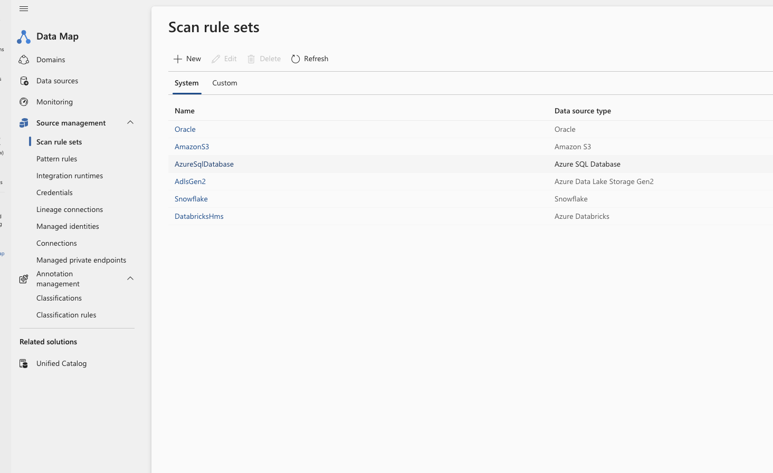
Classification – Setup Scan Rule sets for the scan of sources in the Data Map.
The scans relies on Scan Rule sets to find, and mark classified information when registering the data assets
Note:
A scan rule set belongs to a technology
A list of sources and how to configure them can be found here.

Slide 31
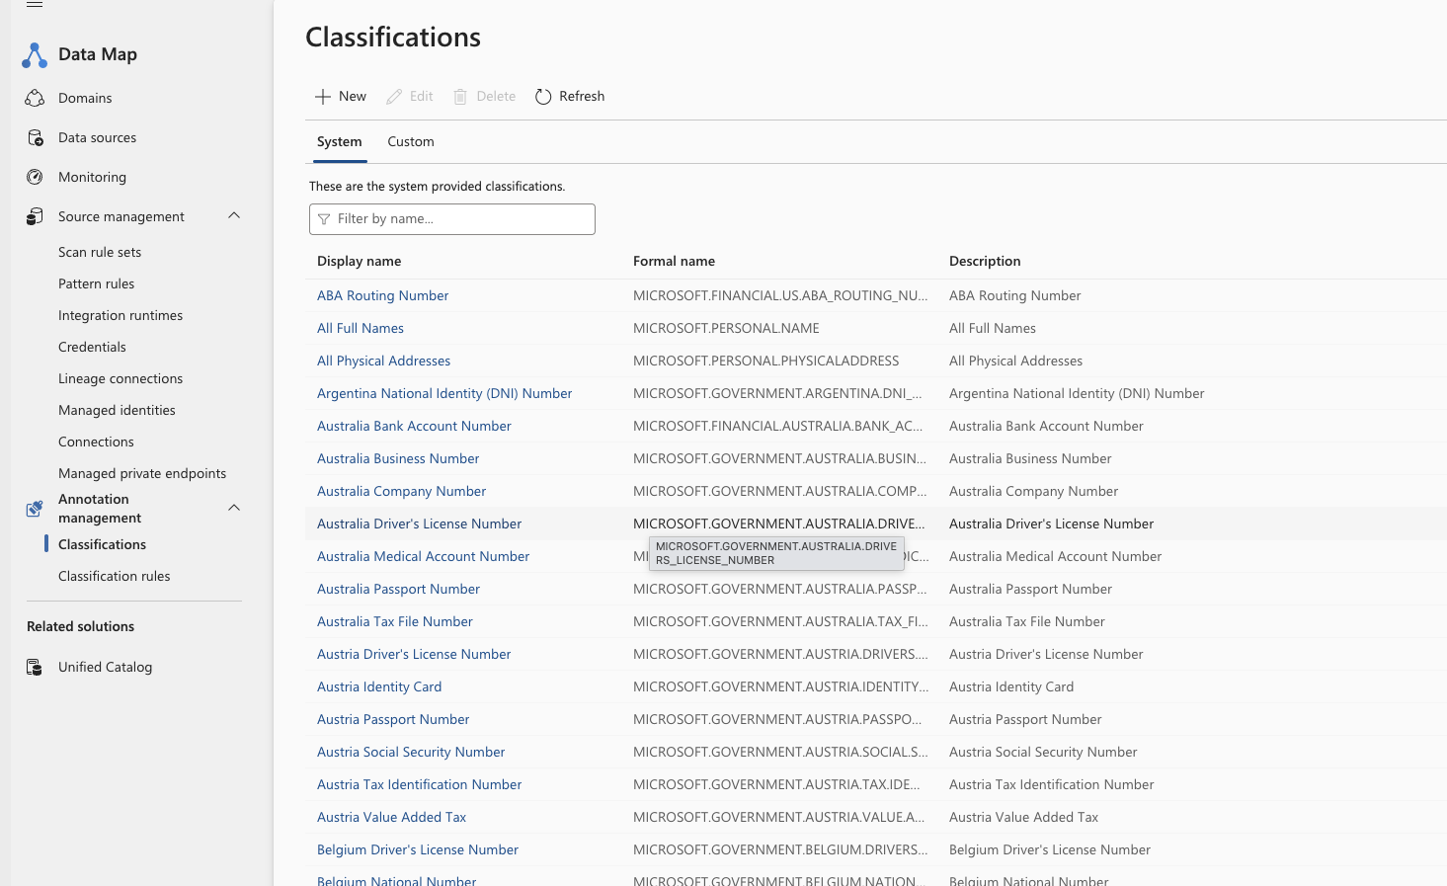
Classification –Scan Rule sets consists of one or more classification.
The classifications describes the different categories.
Note:
Classifications can either be build-in (System) or custom

Slide 32
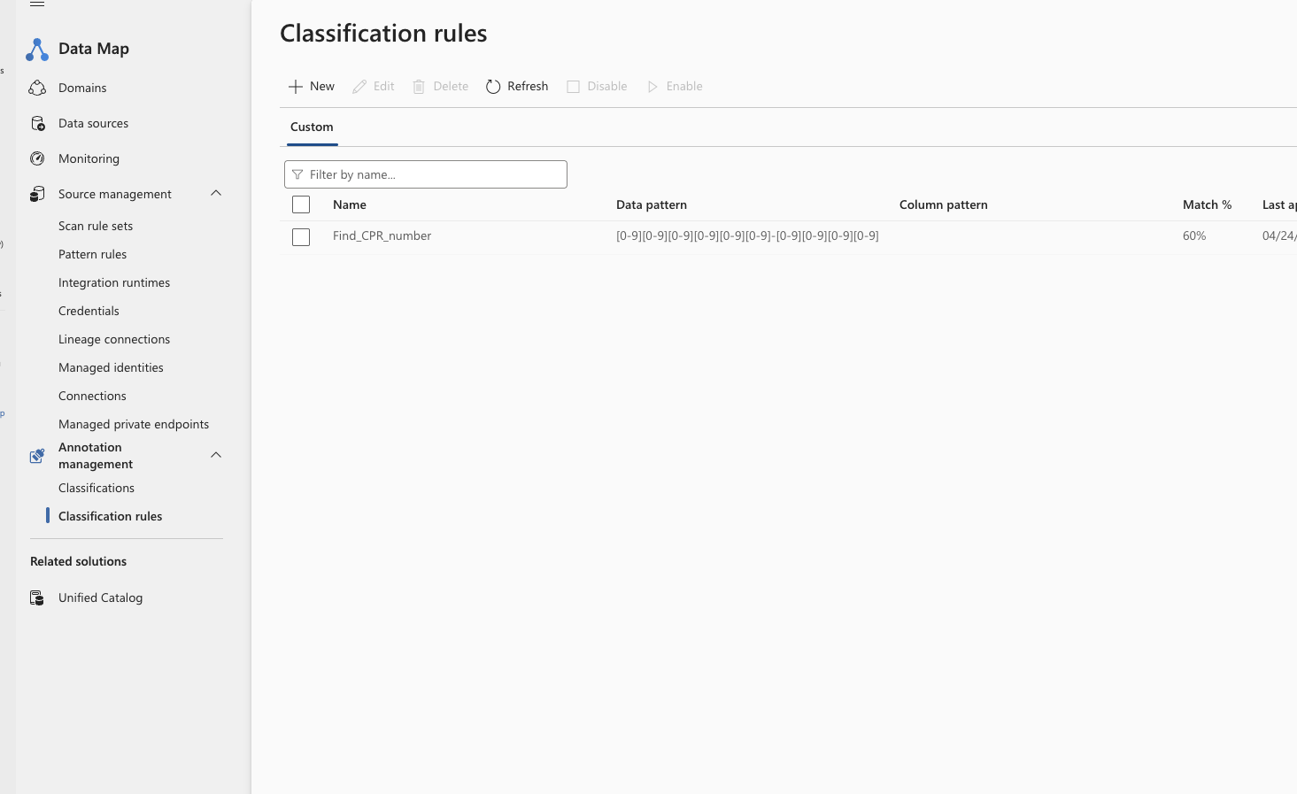
Classification – Classifications consists of one or more classification rules.
The classifications rules defines the “pattern” of the element the scan should find.
Note:
Each system classification also has a rule, but those are not listed here.
Information about those can be found here.

Slide 33
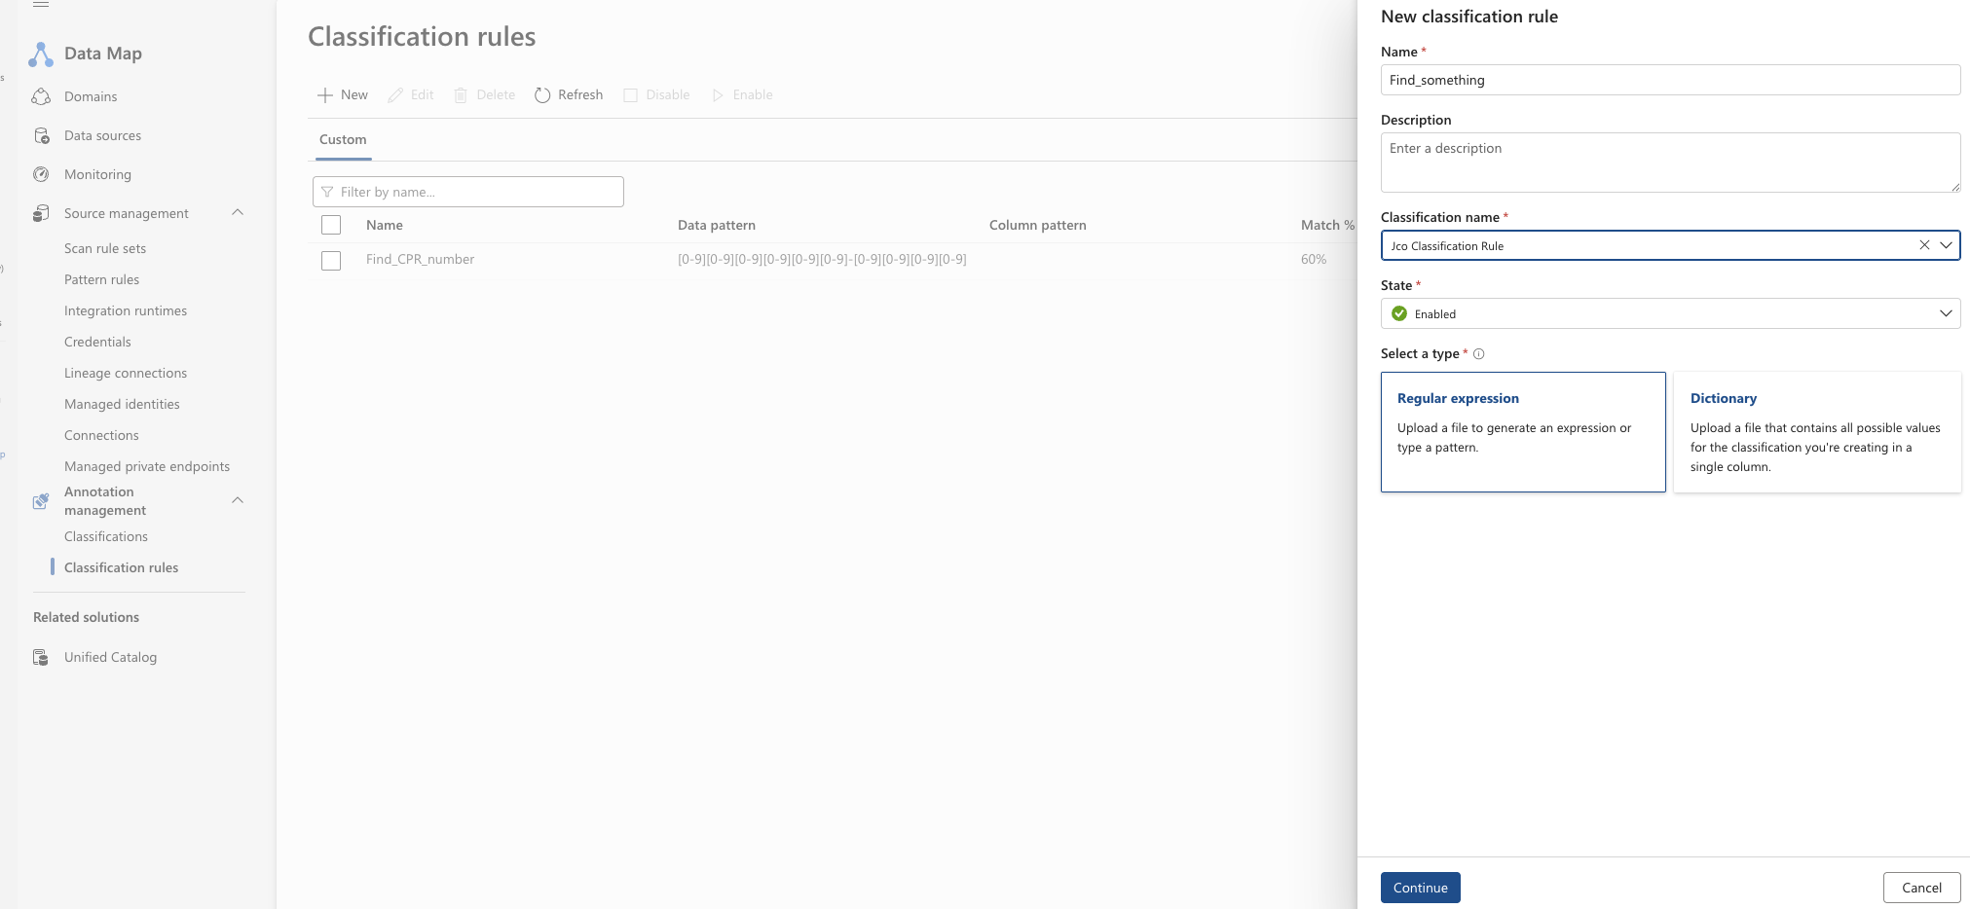
Classification – Classification rules creation
The classifications rule has a name and belongs to a classification
Note:
Classifications rules can either be a regular expression or a list values.

Slide 34
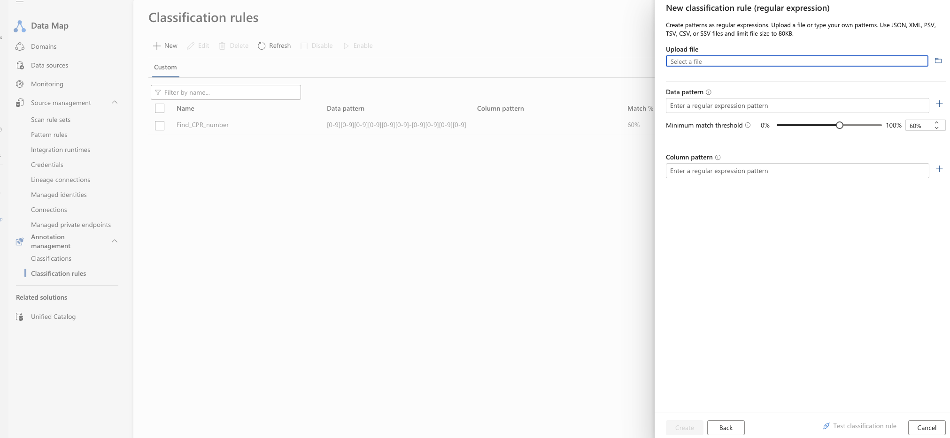
Classification – Classification rules creation
The regular expressions can define one or more “patterns” in the data itself and/or the name of the columns.
Note:
You can make any combination of rules of data or column names

Slide 35
Sensitivity labels
Gives you possibility to mark data assets to reflect the intended usage.
Sensitivity labels comes from Microsoft 365 and hence you need a license for this.
You can not create these labels within Purview itself.
Sensitivity labels often has a structure like Public -> Internal -> Confidential. This represents a way of handling files/mails, where we want to be able to control how those can be distributed. The challenge here is that the Purviews Data Governance part handles databases -> Tables -> Columns. So, care should be taken on how to use sensitivity labels on data assets.
Also note that Purview Data Governance is “passive”, it does not enforce – nor have the capability to enforce – such labels.
For guidance on Microsoft 365 please see here - https://learn.microsoft.com/en-us/purview/sensitivity-labels

Slide 36
Edit a data asset

Slide 37
To edit a data asset
To edit a data asset, you can either press edit, to edit a single asset or press Select for bulk edit to mark this asset to a list where you edit multiple assets in one go. Note – you can add tags without pressing edit.

Slide 38
Edit a single data asset

Slide 39
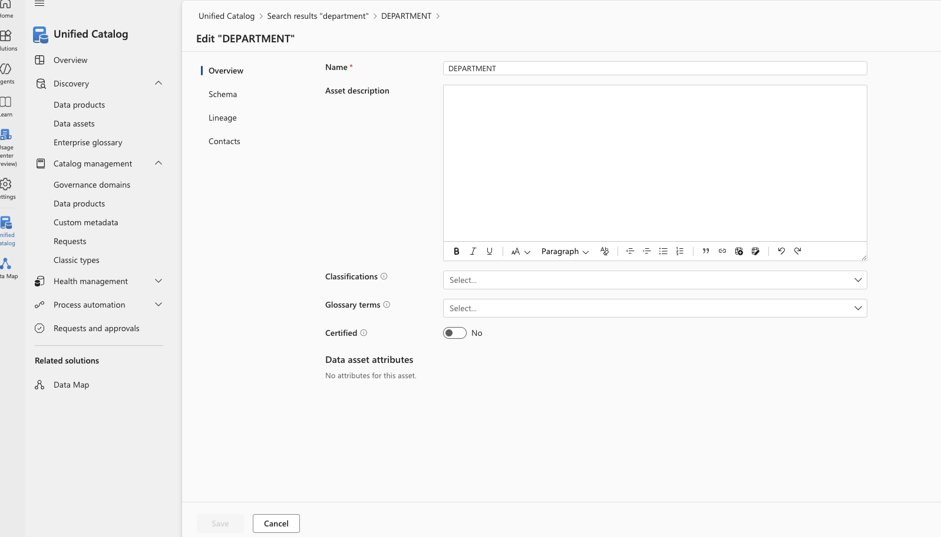
1a - Edit a single data asset overview information
Note - The tabs shown are in the same order as the ones when viewing the data asset, but only the ones where you can edit information.
Name - you can enter another name for the data asset, the original name is kept, but then not shown.
Asset description - any text reflecting the data asset.
Classification – you can add/change classification connected to this data asset (see here)
Glossary terms - you can add/change glossary terms suitable for this data asset (see here)
Certified – is a “simple” yes/no button. Can be used to distinguish between reviewed and not reviews assets.
Data asset attributes - will be available if you you have created “custom attributes” for this data asset type (see here).

Slide 40
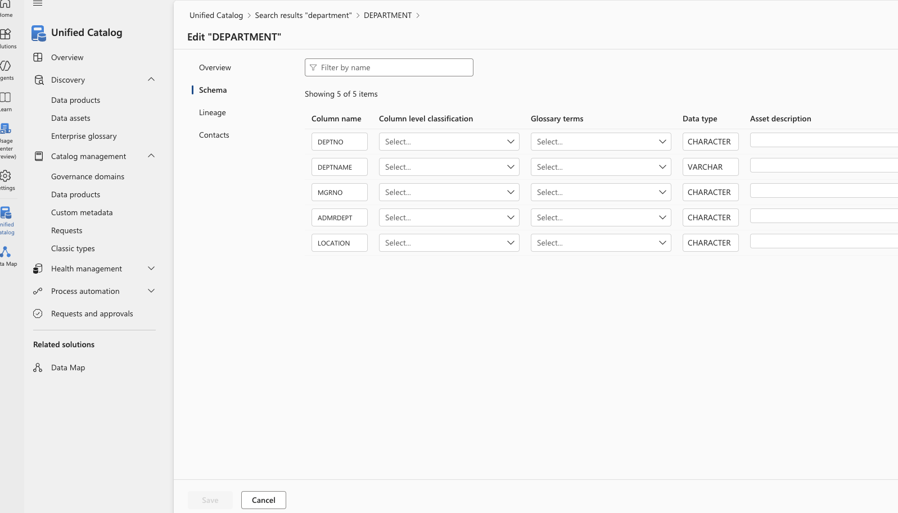
1b - Edit a single data asset – schema information
Column Name - you can enter another name for the data asset, the original name is kept, but then not shown.
Column level Classification – you can add/change classification connected to this data asset (see here)
Glossary terms - you can add/change glossary terms suitable for this data asset (see here)
Data type – you can change the data type for this column. Note that Purview is not concerned about length and precision.
Asset description - any text reflecting the data asset.

Slide 41
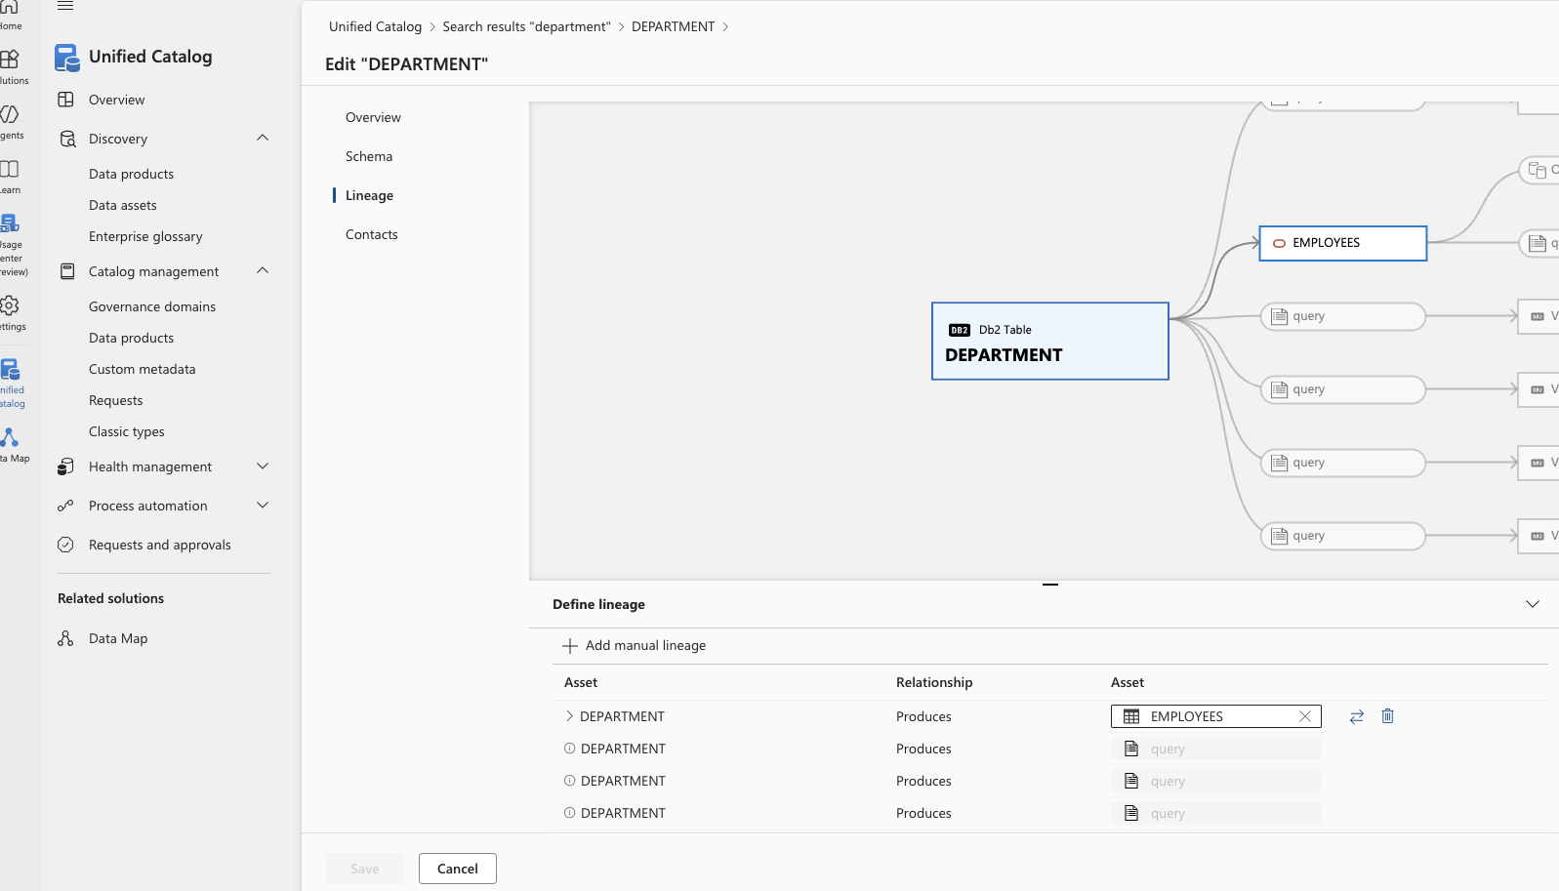
1c - Edit a single data asset – lineage information
On this screen you can add/change lineage information that is wrong or missing.
You can only add lineage to existing data assets.
You can also change the direction of the “lineage”

Slide 42
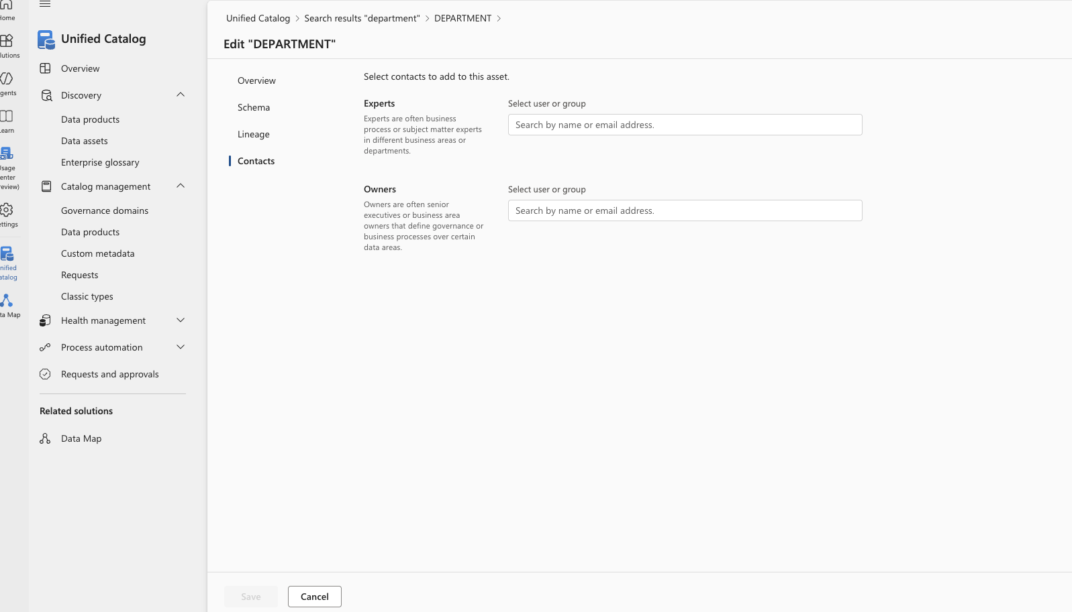
1c - Edit a single data asset – contact information
On this screen you can add/change any number of Experts or Owners for a data asset.
Please note that this can be combination of groups and users.
It is preferable to only use groups and then maintain the users in these group using Entra ID.

Slide 43
Edit multiple data asset

Slide 44
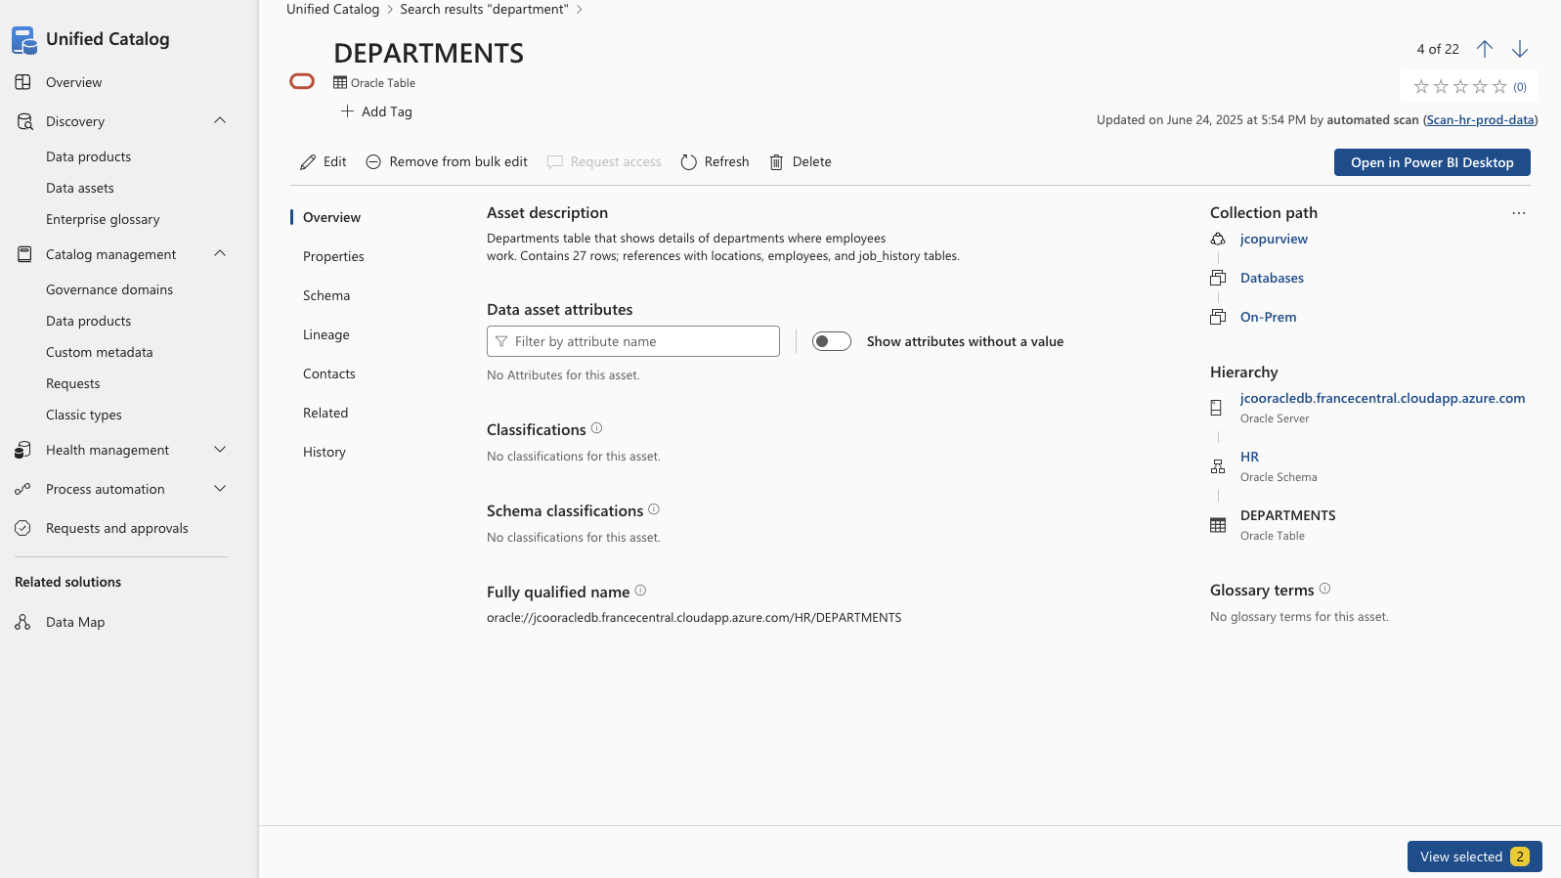
2a - Select data assets to be bulk edited
When you press Select for bulk edit the number of selected data assets are show in the bottom of the screen.
You could press Remove from bulk edit if you made a wrong selection.
When you are ready to continue with the bulk edit process, press View selected

Slide 45
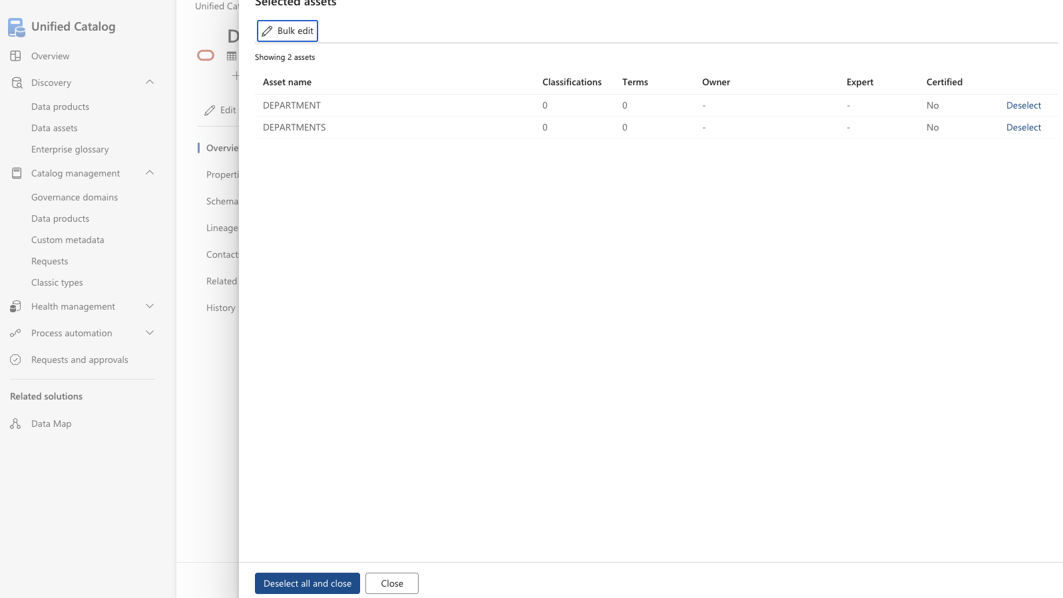
2b - Select data assets to be edited
This screen shows the data assets Selected for bulk edit.
You can press Bulk edit and proceed.
You can also press Deselect all and close to abort the bulk edit operation.
Or you can press Close and continue adding more data assets for bulk edit.

Slide 46
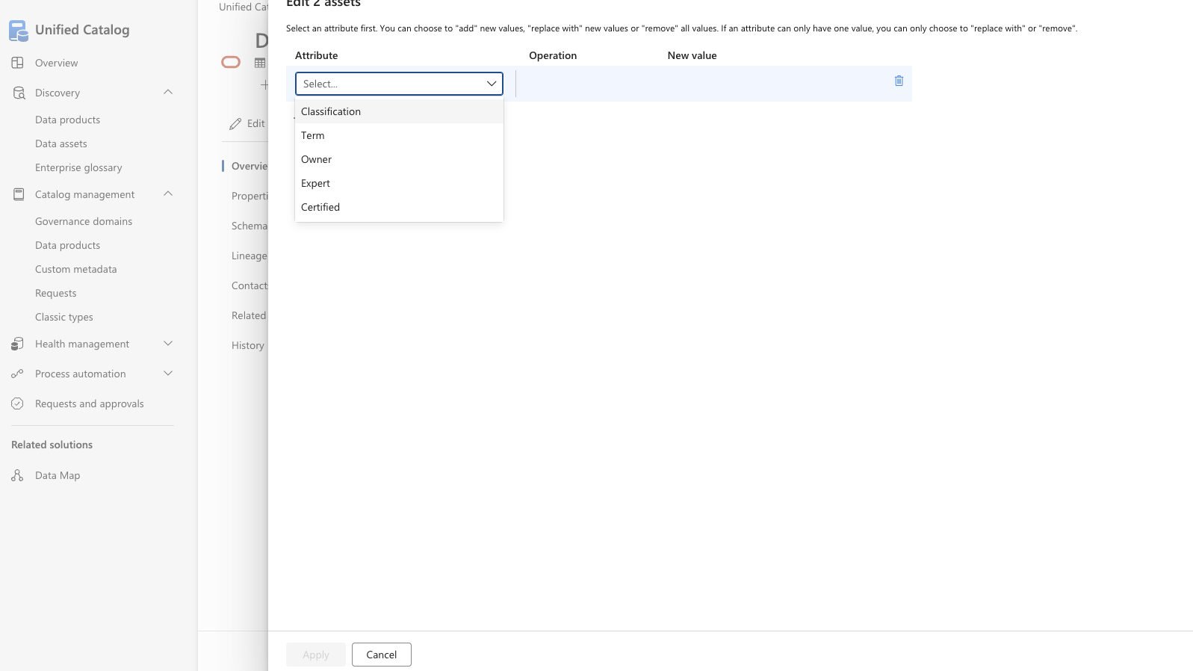
2c – Choose attributes for be bulk edited for the data assets
On this screen you can choose any number of combinations
of Attribute, Operation and New Value.
Attribute can be Classification, Term (Glossary), Owner, Expert or Certified.
Operation can be Add, Replace with or Remove.
New value is the value that should be used with the Operation.
The Apply button will make Purview do the changes.

Slide 47
Other items in Data Map
Data Map

Slide 48
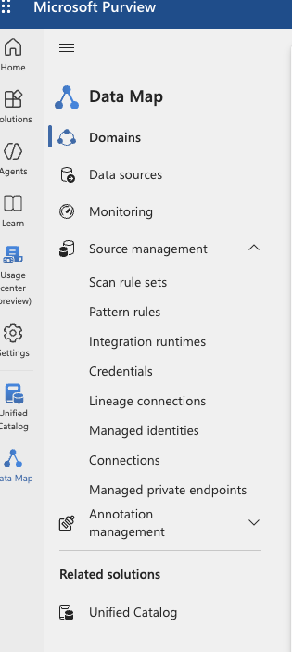
In the Data Map you will find also find other items.
Pattern rules – this item is only available if you updated an existing Purview account to the new portal. It covers resource sets.
Integration Runtimes – here you can see/register integration runtimes used by Purview for scans/data quality.
Credentials – for registering/seeing the different KeyVault stores Purview uses to get credentials for the login into the sources.
Lineage connections – for seeing/creating connection to Azure Data Factory and Azure Data Share used with Purview.
Managed Identities – points you to use the Azure Portal to maintain these identities.
Connections – connections used for workflows and protection policies (NOT for data quality)
Managed private endpoints – if you have setup Purview with Private Endpoint, connections can be maintained here.

Slide 49
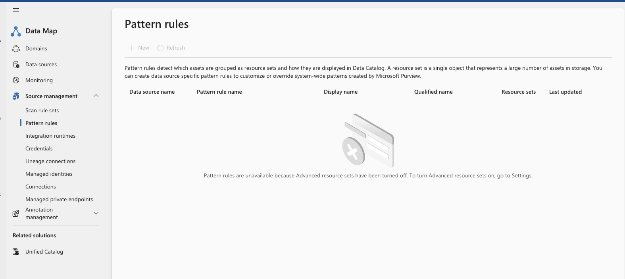
Data Map – Pattern Rules

Slide 50
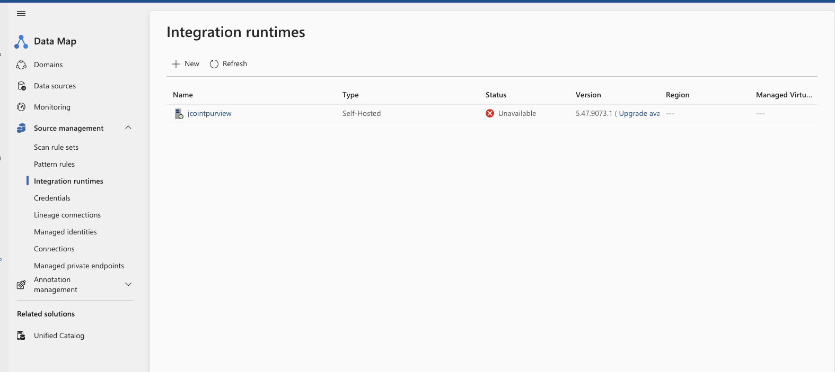
Data Map – Integration Runtimes

Slide 51
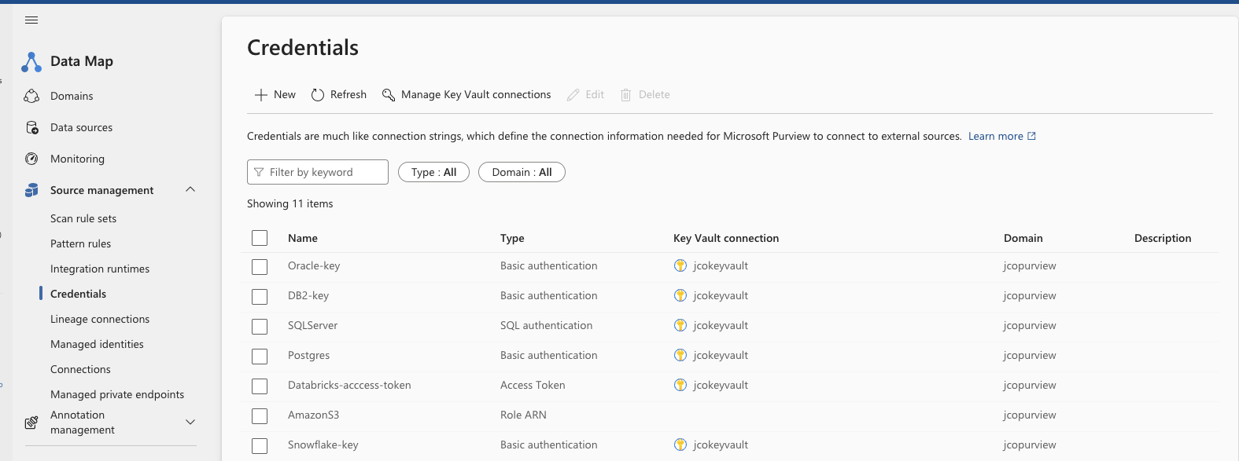
Data Map – Credentials

Slide 52
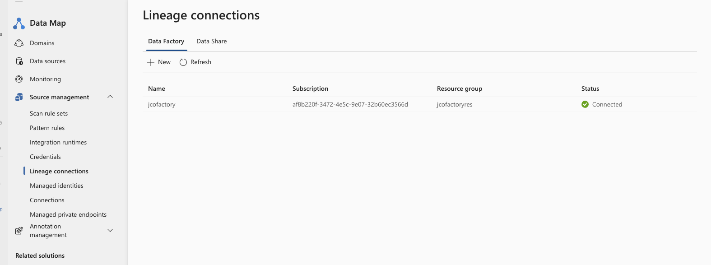
Data Map – Lineage connections

Slide 53
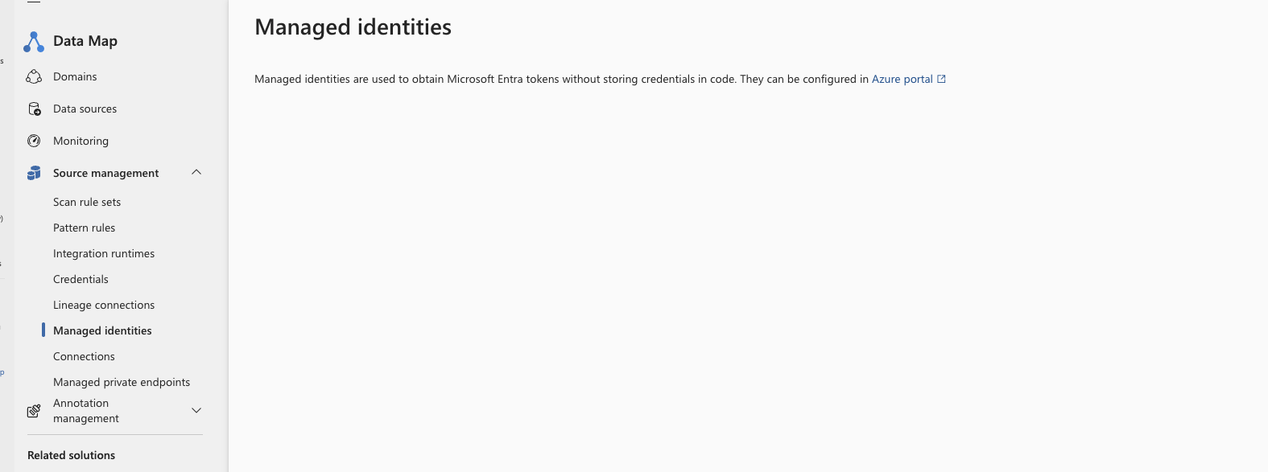
Data Map – Managed identities

Slide 54
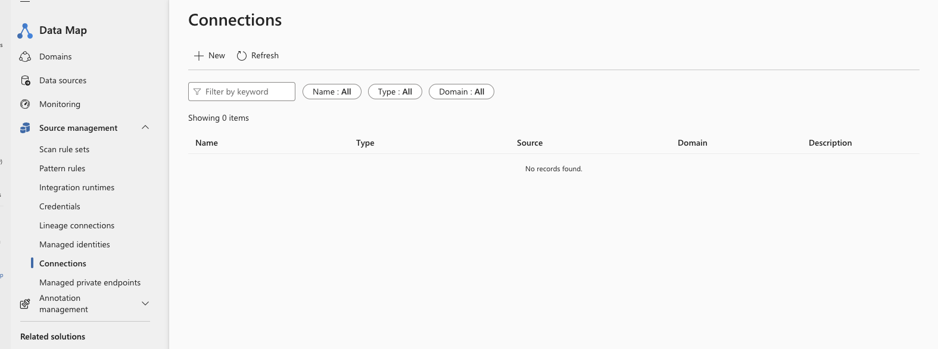
Data Map – Connections

Slide 55
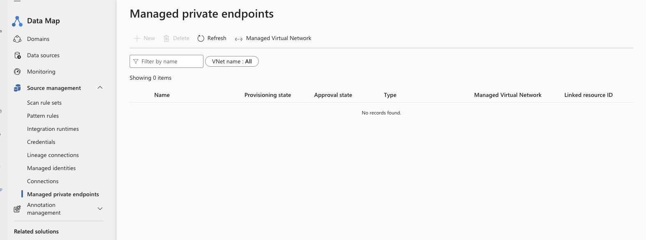
Data Map – Private Endpoints

